Slide 1
CSCI 6234 Assignment 4
Group 10:
Mingqian Liu
Zhibo Sheng
Kai Wang
Junwen Wen

Slide 2
Actors
Users: include participants and moderators
Participants: normal users
Moderators: users with extra privileges
Movie API/Server: provide movie service

Slide 3
Use Cases
1. Use Case ID: USR01
Use Case Title: Sign in
Use Case Description: users sign in to system
Preconditions: a user has an account or want to have one
Postconditions: user logged in or registered successfully
Steps: 1. Users click the “sign in” button. 2. Users fill in the ID and password then click “ok” to sign in. 3. System displays sign in successful
2.Use Case ID: USR02
Use Case Title: Sign out
Use Case Description: users sign out to system
Preconditions: a user has signed in the system
Postconditions: system displays signed out successful
Steps: 1. Users click on the “sign out” button. 2. System displays sign out successful

Slide 4
Use Cases
3.Use Case ID: USR03
Use Case Title:Create watcher group
Use Case Description: moderator creates watcher groups
Preconditions: a user has logged in as a moderator
Postconditions: a watching group is created
Steps: 1. Moderator clicks the “create watecher group” button. 2. System shows the new group
4.Use Case ID: USR04
Use Case Title:Invite to group
Use Case Description: moderator invites users to watcher group
Preconditions: a user has logged in as a moderator; the watcher group is created; the invited users existed
Postconditions: new users joined in the watcher group
Steps: 1. Moderator goes to a existed group. 2. click the “invite” button. 3. enter user’s ID then clicks on “submit” button. 4. System displays “invitation is sent”

Slide 5
Use Cases
5.Use Case ID: USR05
Use Case Title:Join a watcher group
Use Case Description: users join a watcher group
Preconditions:users have logged in; the watcher group existed
Postconditions: the user can access to the group
Steps: 1. Users click on “subscribe” button. 2. Enter the group ID then press “ok”. 3. System shows subscribe successful.
6.Use Case ID: USR06
Use Case Title: Unsubscribe watcher group
Use Case Description: users unsubscribe watcher group
Preconditions: users have logged in; the watcher group existed
Postconditions: users cannot access to the group
Steps: 1. Users goes to the group page. 2. Users click the “unsubscribe” button. 3. System shows unsubscribe successful

Slide 6
Use Cases
7. Use Case ID: USR07
Use Case Title: Add movies
Use Case Description: moderator populates a list movies to a watcher group
Preconditions: a user has logged in as a moderator; the watcher group existed; movie lists existed
Postconditions: a new movie list shows in the watcher group
Steps: 1. Moderator goes to a group. 2. Moderator click “upload movies ” 3. Select movies then press ok. 4. System shows a updated movie lists in group
8. Use Case ID: USR08
Use Case Title: Pull movie list
Use Case Description: moderator pulls movie lists from API/server
Preconditions: a user has logged in as a moderator; known APIs/servers
Postconditions: the movie lists added to system
Steps: 1. Moderator sends a http request to API. 2. APIs process the request. 3. System shows the movie lists

Slide 7
Use Cases
9. Use Case ID: USR09
Use Case Title:Search and browse movies
Use Case Description: group members search and browse movies
Preconditions: users have logged in; the watcher group existed; movie lists existed; search function is existed
Postconditions: users get the results of searching and all the movies to browse
Steps: 1. Users go to a group. 2. Click “search” button. 3. Enter the movie name then press “ok”. 4.system displays the results
10. Use Case ID: USR10
Use Case Title: Watch the trailer
Use Case Description: group members watch the trailers(populated by the moderator)
Preconditions: users have logged in; the watcher group existed; moderator has populated movies
Postconditions: a trailer is playing
Steps: 1. Users go to the group. 2. Search for a selected movie then submit. 3. Click on the “trailer” that next to the movie. 4.system displays the trailer

Slide 8
Use Cases
11. Use Case ID: USR11
Use Case Title: Access to movie reviews
Use Case Description: group members access to movie reviews(populated by the moderator)
Preconditions: users have logged in; the watcher group existed; moderator has populated movies; movie reviews existed
Postconditions: movie reviews are showing
Steps: 1. Users go to the group. 2. Search for a selected movie then submit. 3. Click on the “reviews” next to the movie. 4. System shows the movie reviews.
12. Use Case ID: USR12
Use Case Title: Create a movie watching event
Use Case Description: moderator creates a movie watching event
Preconditions: a user has logged in as a moderator
Postconditions: a new movie event added to system
Steps: 1. Moderator click the “create movie events”. 2. Set the date. 3. System displays the successful feedback

Slide 9
Use Cases
13. Use Case ID: USR13
Use Case Title:Open and close a voting
Use Case Description: moderators open and close a voting to movie events
Preconditions: a user has logged in as a moderator; a voting exists before close it; movie events existed
Postconditions: a movie event can be voted; the voting to a movie event is closed
Steps: 1.moderator goes into the event. 2.click “open” or “close” a voting. 3. System shows a new voting or shut down a voting
14.Use Case ID: USR14
Use Case Title: Notified by events and voting
Use Case Description: group member are notified new events and new voting
Preconditions: users have logged in; the watcher group existed; new event created; voting is open
Postconditions: group members knew the new event and new voting
Steps: 1.moderators have the “notify group members”box checked when they publish events and votings. 2. System sends notification email to group members.

Slide 10
Use Cases
15. Use Case ID: USR15
Use Case Title:Cast votes
Use Case Description: group members cast votes for movies in movie events
Preconditions:users have logged in; the watcher group existed; the moderator created the events; the voting is open
Postconditions: group members their votes
Steps: 1. Group members click on the “voting”. 2. Choose a movie name then submit. 3. System displays vote successful info.
16. Use Case ID: USR16
Use Case Title: Check histories
Use Case Description: group members check histories of movie events, votes, and winners
Preconditions: users have logged in; the watcher group existed; the moderator created the events; the voting is closed; the winners existed
Postconditions: the histories of movie events, votes, and winners are showing
Steps: 1. Group members click on “history”. 2. Choose movie events, votes, or winners. 3. System displays the results

Slide 11
Use Cases
17.Use Case ID: USR17
Use Case Title:Sign up
Use Case Description: sign up to system
Preconditions: a user does not have an account
Postconditions: user l registered successfully
Steps: 1. Users click the “sign up” button. 2. Users fill out the personal info then click “ok” to sign up. 3. System displays sign up successful

Slide 12
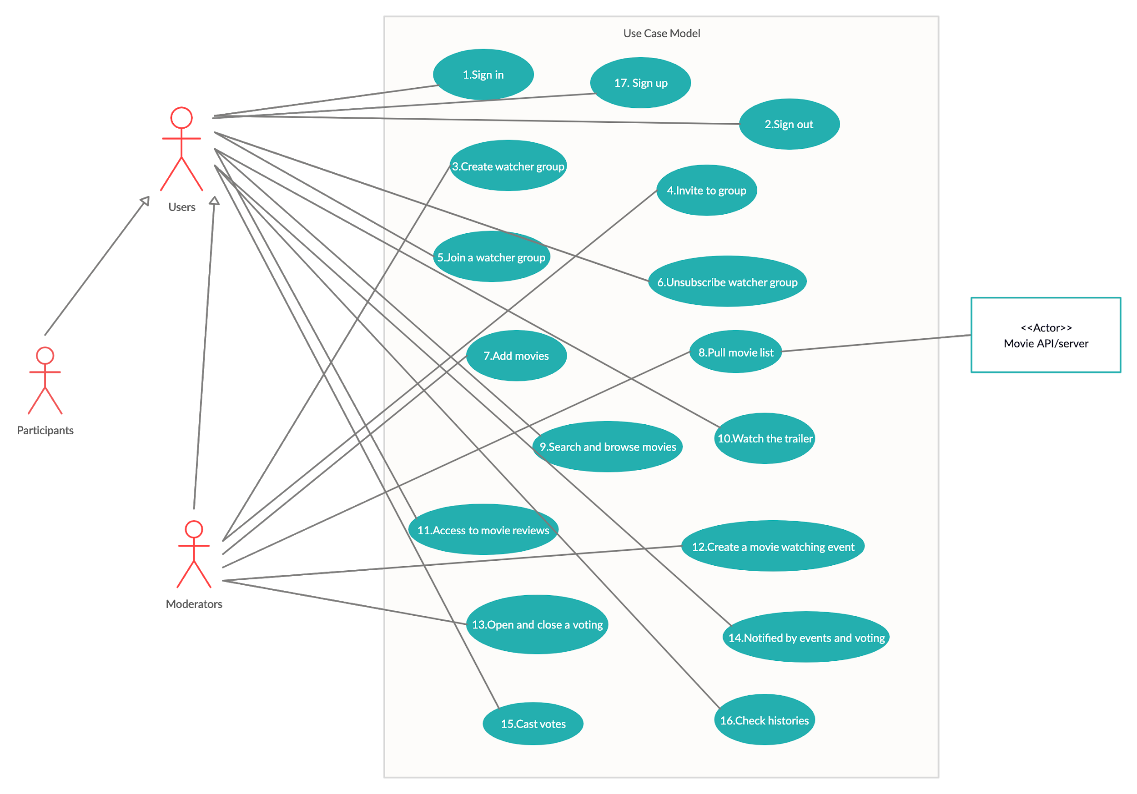
Use Case Diagram

Slide 13
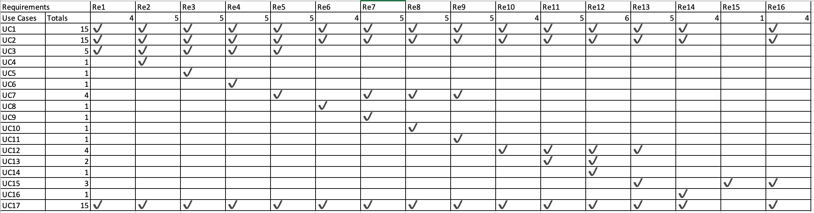
Bi-direction Traceability Matrix

Slide 14
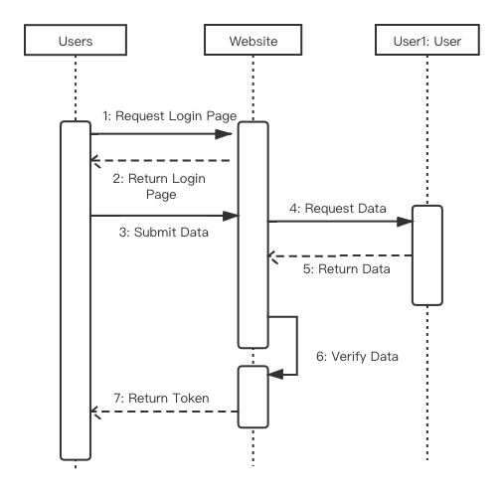
Sequence Diagram
1.Sign in/up

Slide 15
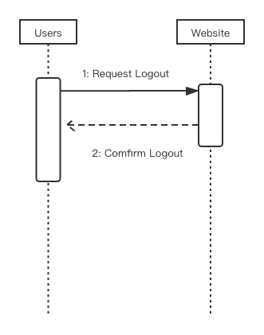
Sequence Diagram
2.Sign out

Slide 16
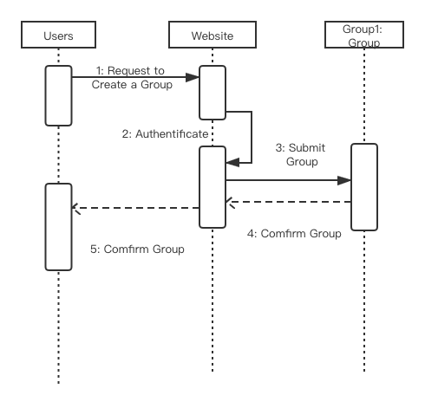
Sequence Diagram
3.Create watcher group

Slide 17
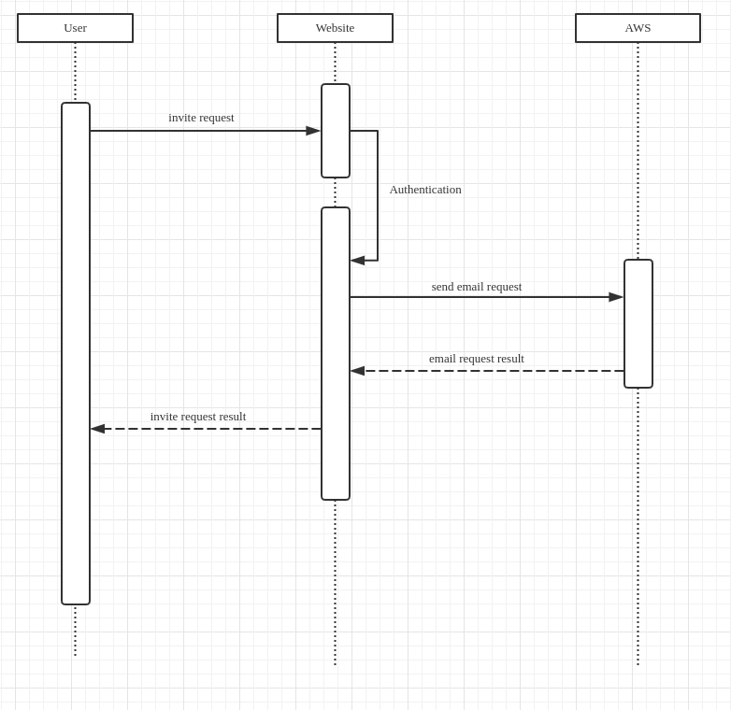
Sequence Diagram
4.Invite to group

Slide 18
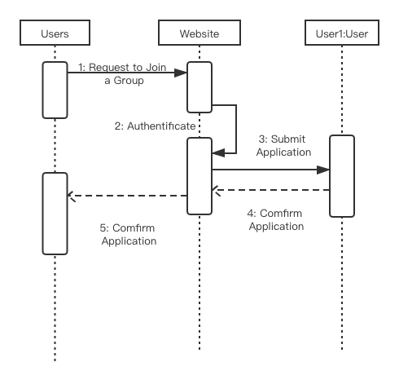
Sequence Diagram
5.Join a watcher group

Slide 19
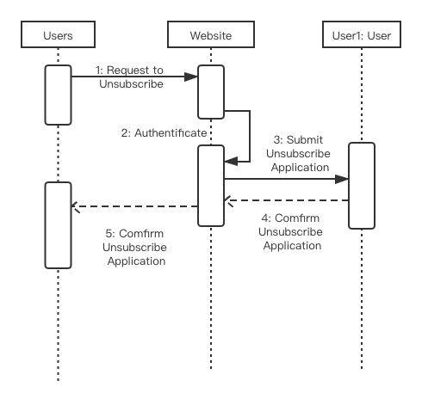
Sequence Diagram
6.Unsubscribe watcher group

Slide 20
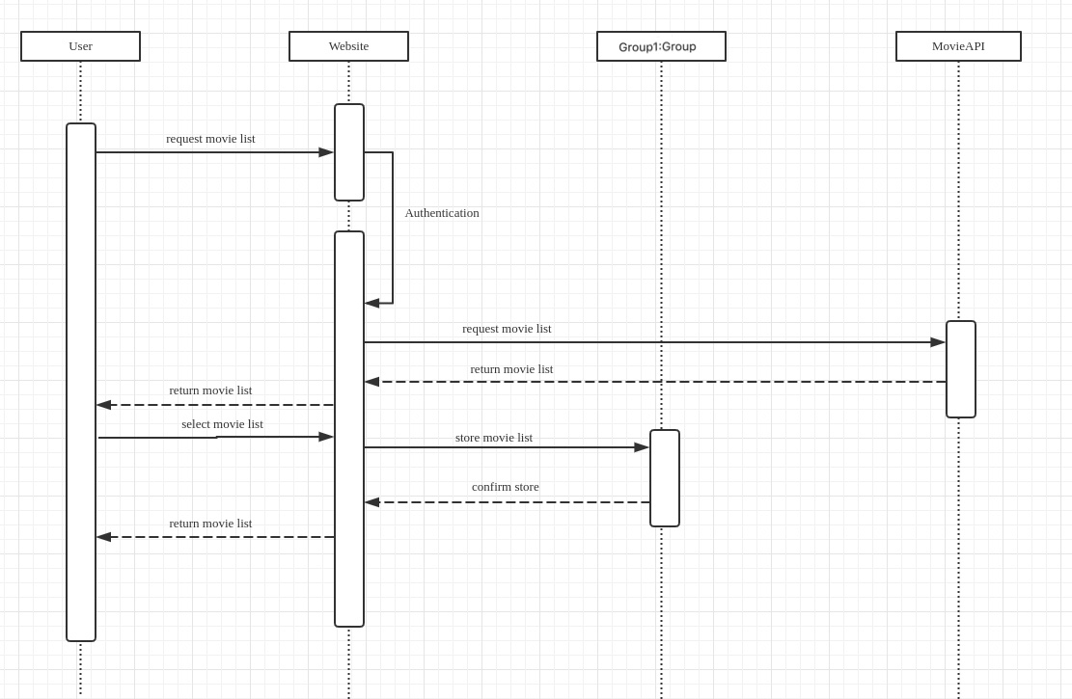
Sequence Diagram
7.Add movies
And
8.Pull movie list

Slide 21
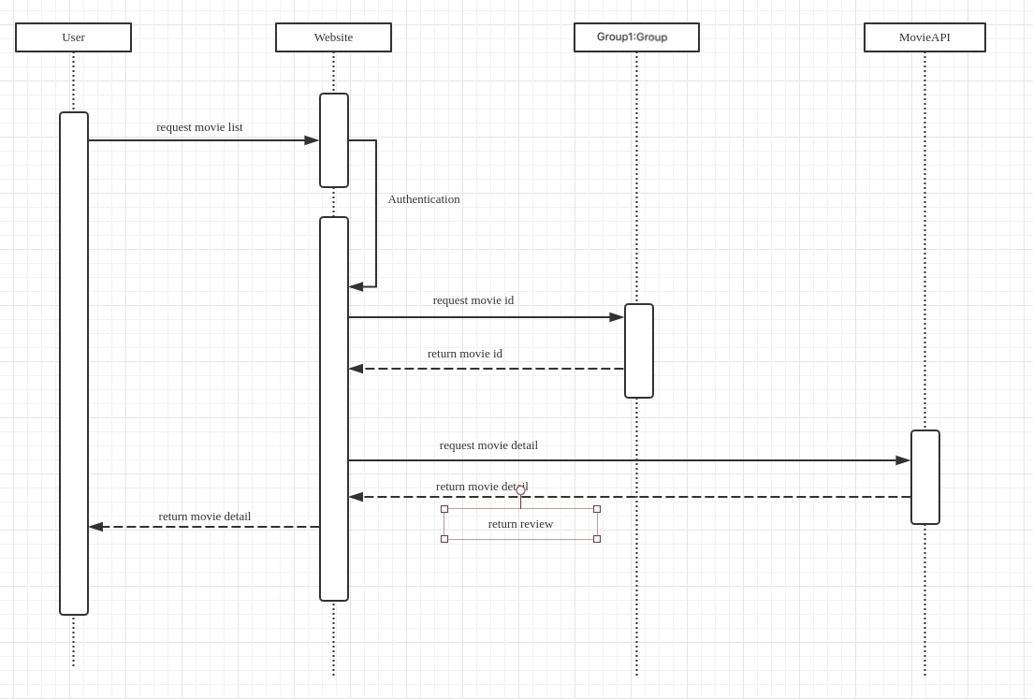
Sequence Diagram
9.Search and browse movies

Slide 22
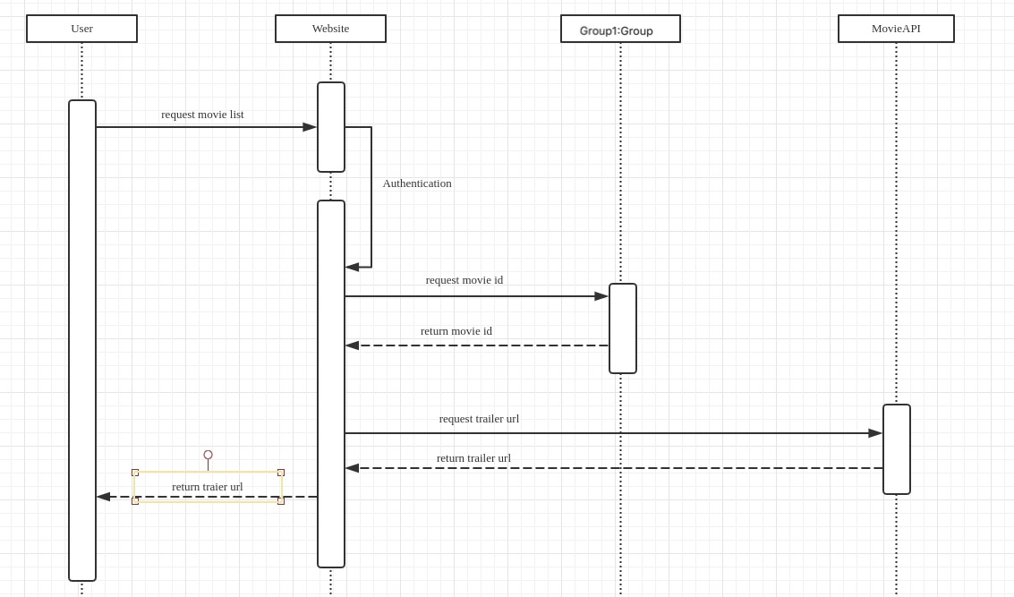
Sequence Diagram
10.Watch the trailer

Slide 23
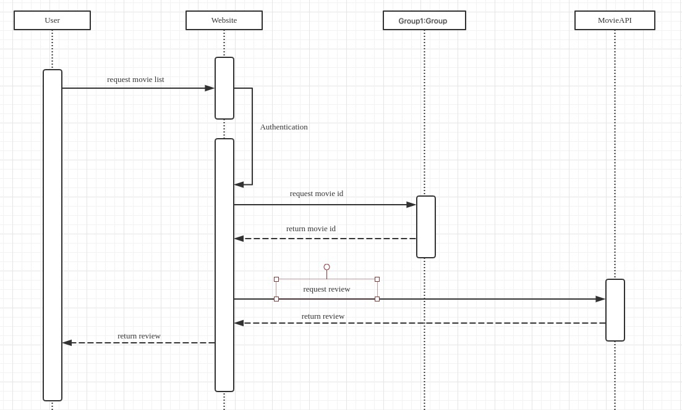
Sequence Diagram
11.Access to movie review

Slide 24
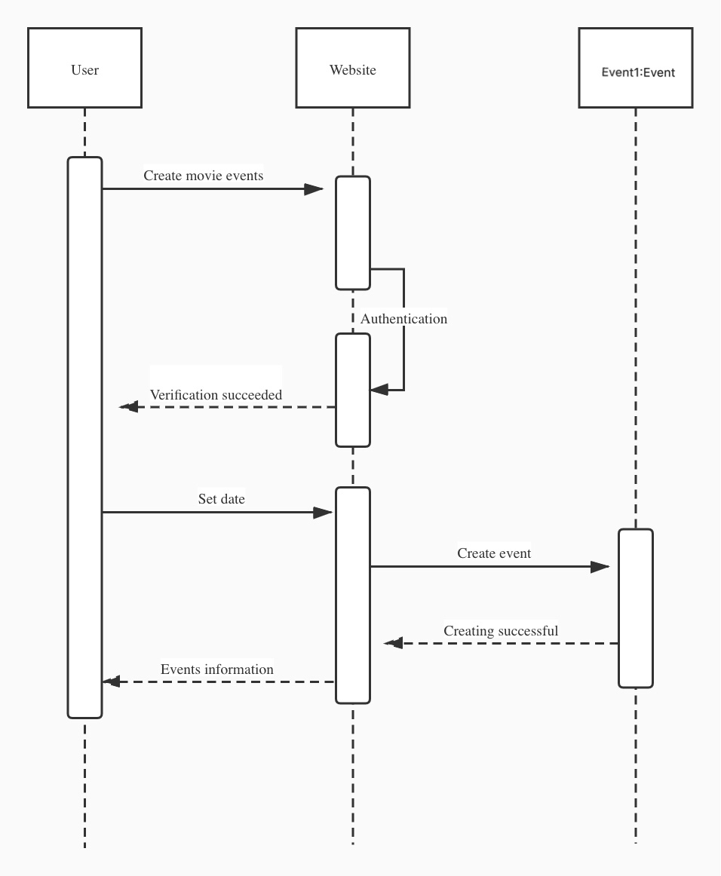
Sequence Diagram
12.Create a movie watching event

Slide 25
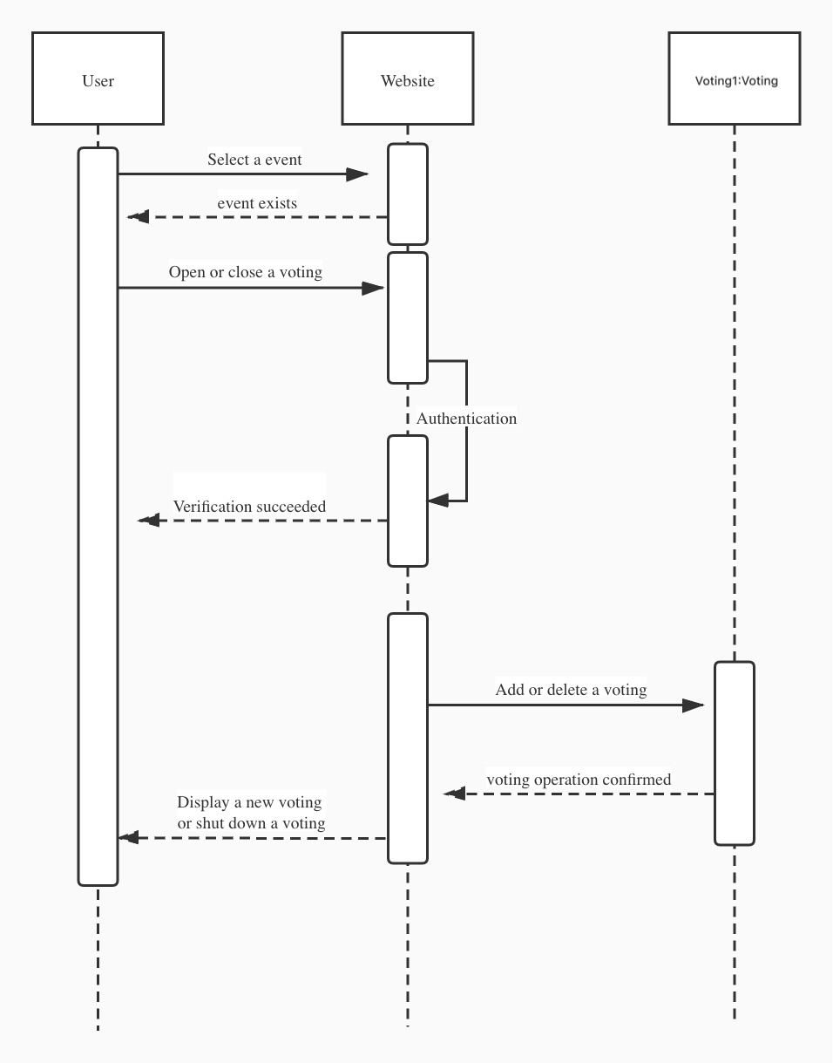
Sequence Diagram
13.Open and close a voting

Slide 26
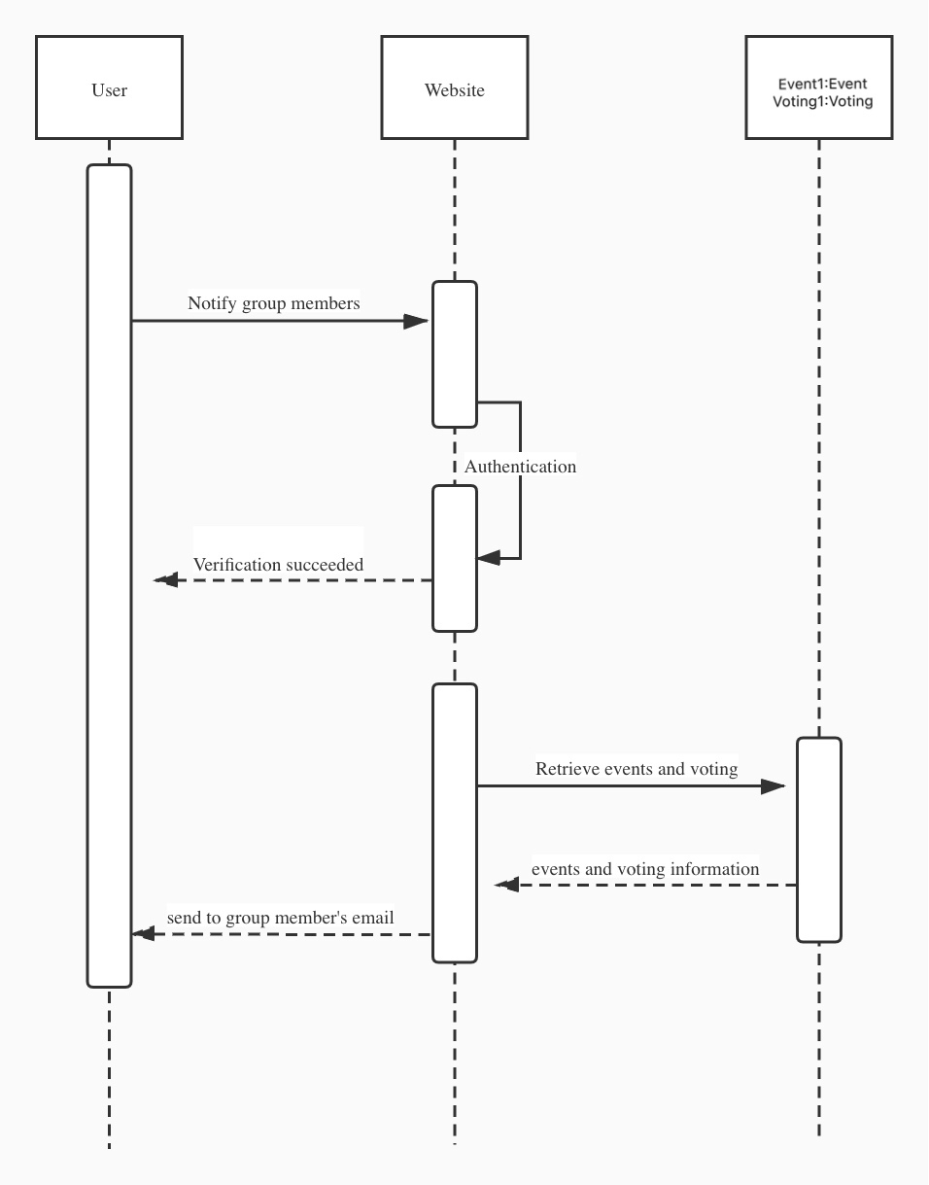
Sequence Diagram
14.Notified by events and voting

Slide 27
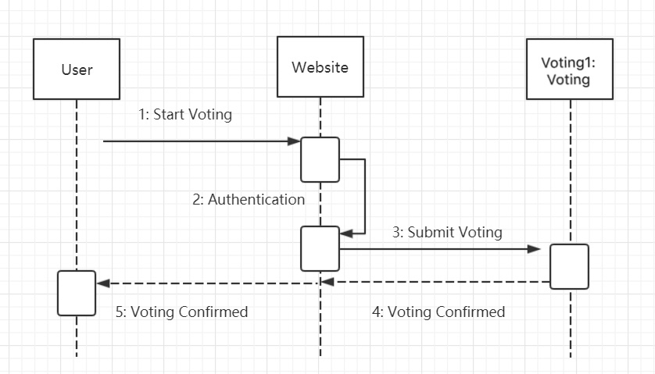
Sequence Diagram
15.Cast votes

Slide 28
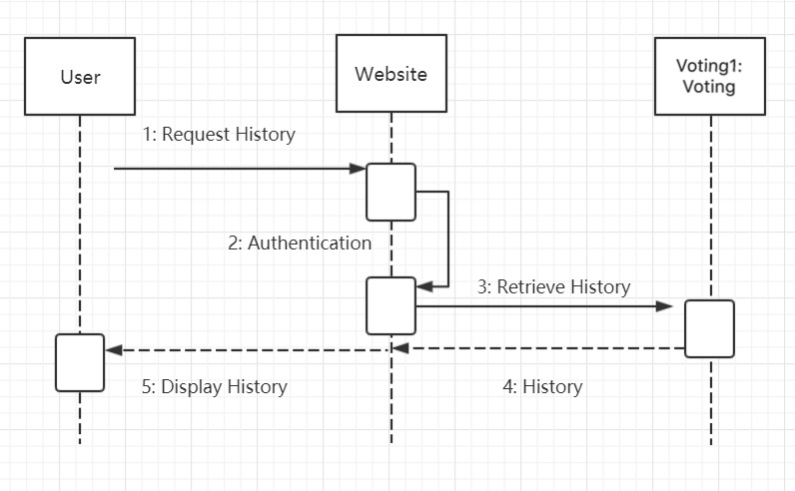
Sequence Diagram
16.Check histories

Slide 29
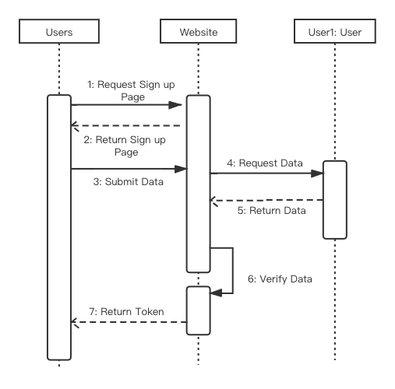
Sequence Diagram
17.Sign up

Slide 30
Class Diagram Model
User class maintain the data for the users include the moderators and participants
Group class maintain the data for the watch group which is created by moderators
Event class maintain the data for the event which is created by group
Voting class maintain the data for the voting which is created by event

Slide 31
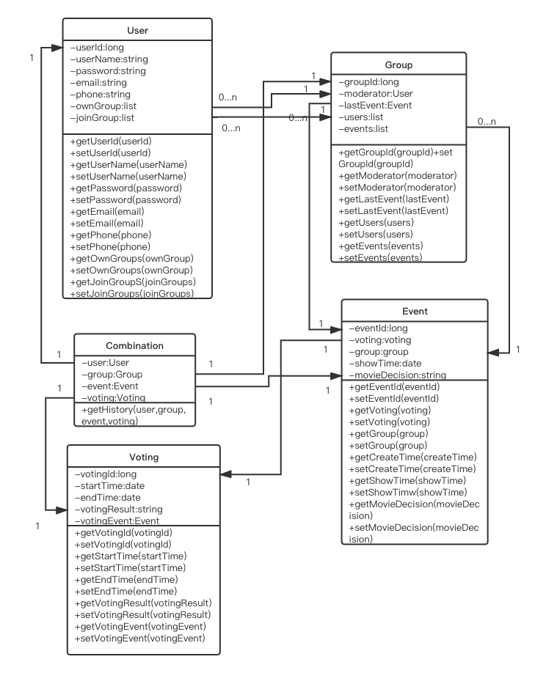
Class Diagram Model

Slide 32
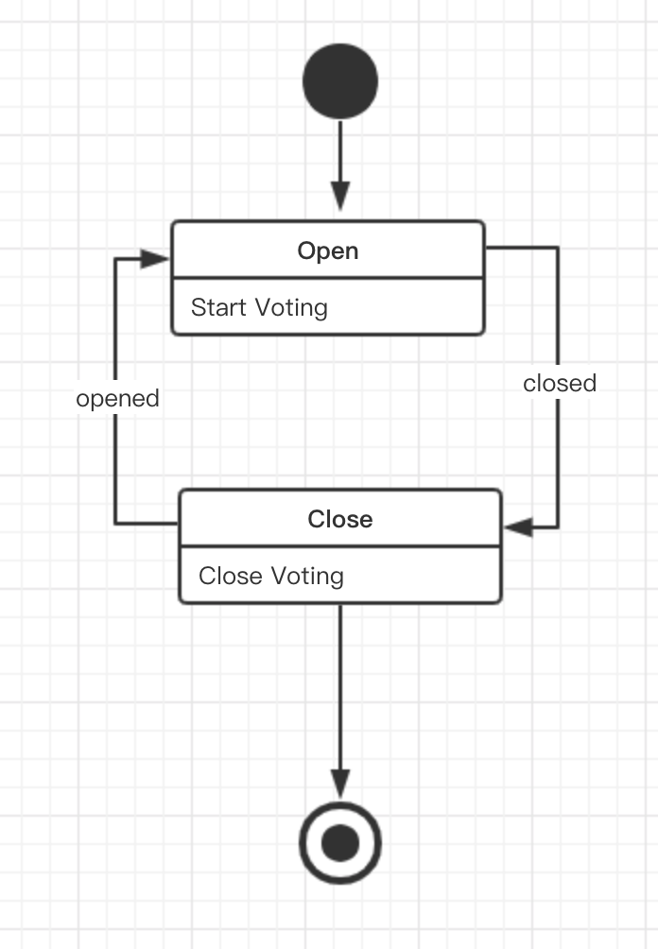
State Diagram

Slide 33
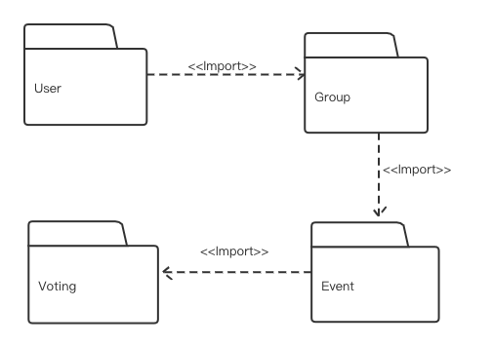
Package Diagram: entity classes

Slide 34
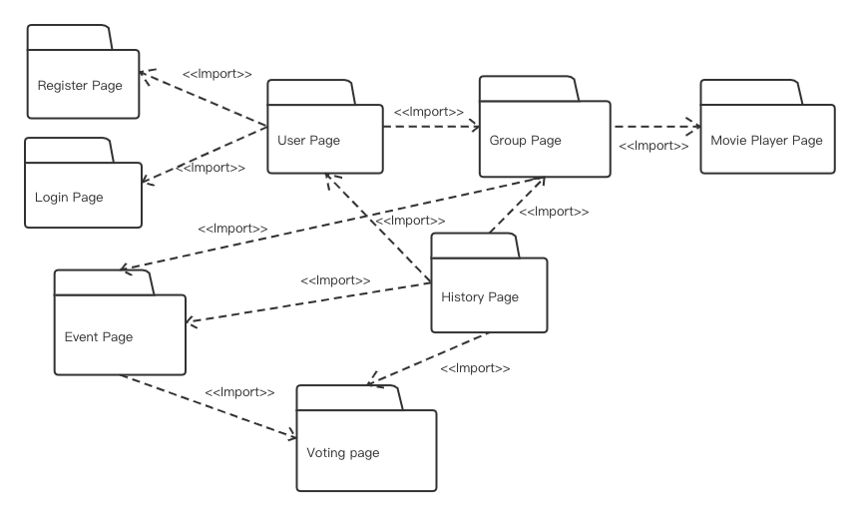
Package Diagram: view classes

Slide 35
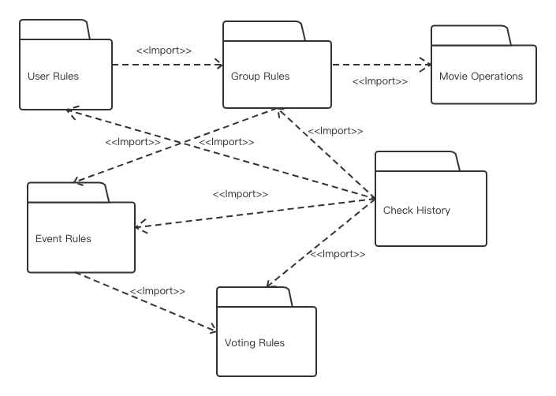
Package Diagram: control classes

